Slide 1
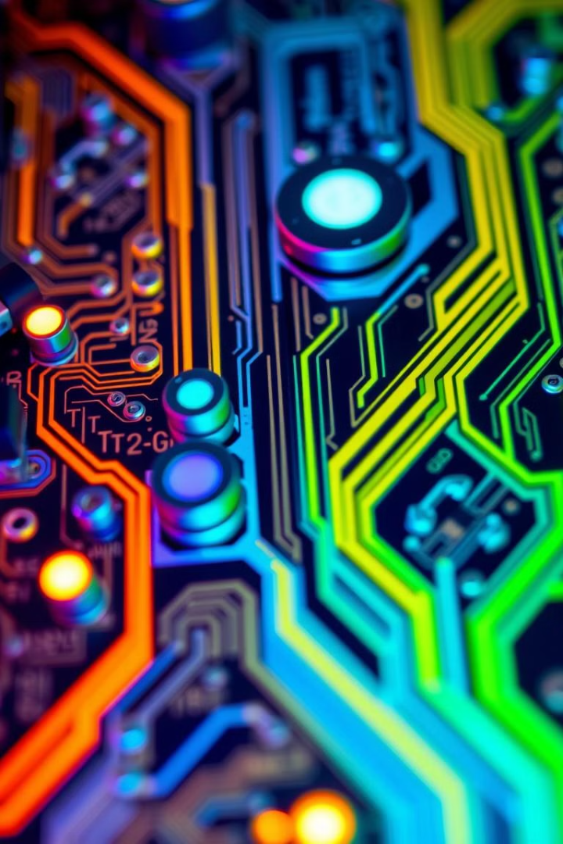
Hardware Implementation of Quantum Automata for Cryptography
Quantum automata, with their unique capabilities, hold immense potential for transforming cryptographic security. This presentation will explore the hardware requirements, design principles, and practical applications of quantum automata in the field of cryptography.

Slide 2

Introduction to Quantum Computing
1
Quantum Phenomena
2
Qubit-Based Architecture
Quantum computing leverages the principles of quantum mechanics, such as superposition and entanglement, to perform computations.
Quantum computers use qubits, which can exist in multiple states simultaneously, unlike classical bits.
3
Exponential Potential
Quantum computers have the ability to perform certain computations exponentially faster than classical computers.

Slide 3
Principles of Quantum Automata
State Transitions
Quantum Algorithms
Reversible Computation
Quantum automata operate based on probabilistic state transitions, unlike classical deterministic automata.
Quantum automata utilize specialized quantum algorithms, such as Grover's algorithm and Shor's algorithm, for efficient problem-solving.
Quantum automata are designed to perform reversible computations, which is a key requirement for quantum algorithms.

Slide 4
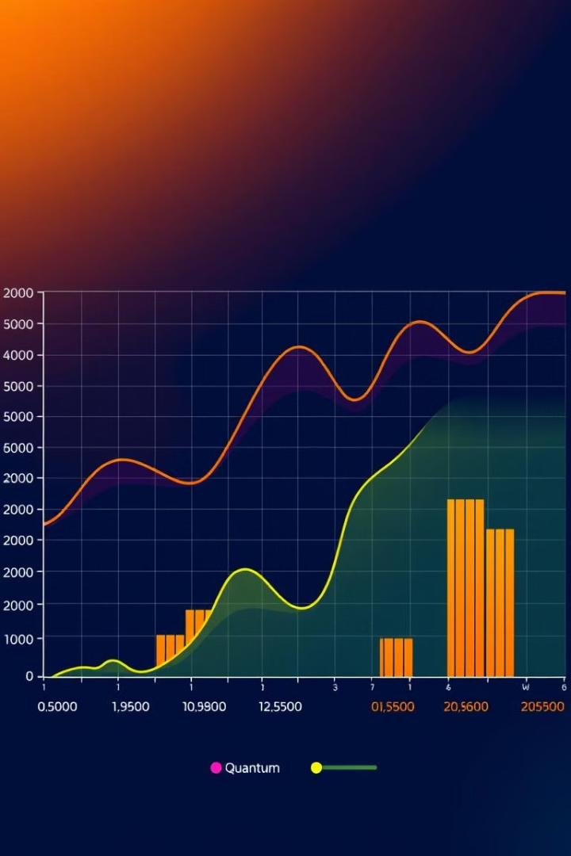
Advantages of Quantum Automata
1
Computational Speed
Quantum automata can perform certain computations exponentially faster than classical computers, enabling new levels of efficiency.
2
Security Enhancement
Quantum cryptography based on quantum automata offers enhanced security by leveraging the principles of quantum mechanics.
3
Improved Simulation
Quantum automata excel at simulating complex quantum systems, which is crucial for research and development in various fields.

Slide 5

Hardware Requirements for Quantum Automata
Qubit Processors
Cryogenic Cooling
Quantum automata require specialized qubit-based processors, with qubits maintained in a fragile quantum state.
Maintaining the delicate quantum state of qubits requires an extremely low-temperature environment, typically achieved through cryogenic cooling systems.
Precision Control
Quantum Memory
Precise control and manipulation of quantum states is essential for the proper functioning of quantum automata.
Reliable quantum memory is crucial for storing and processing quantum information within the quantum automata.

Slide 6





Circuit Design for Quantum Automata
Quantum Gates
Qubit Manipulation
Quantum Entanglement
Error Correction
Quantum automata rely on specialized quantum logic gates to perform quantum computations.
Precise control and manipulation of qubits is essential for the circuit design of quantum automata.
Exploiting the phenomenon of quantum entanglement is crucial for achieving efficient quantum computations.
Robust error correction techniques are necessary to mitigate the fragile nature of quantum states.

Slide 7




Quantum Error Correction Techniques
Quantum Decoherence
Qubits are highly susceptible to environmental interference, leading to quantum decoherence and errors.
Redundancy Encoding
Quantum error correction employs redundancy encoding, where multiple qubits represent a single logical qubit.
Quantum Error Correction Codes
Specialized quantum error correction codes, such as the Shor code, are used to detect and correct errors in quantum computations.

Slide 8
Cryptographic Applications of Quantum Automata
Quantum Key Distribution
Factorization of Large Numbers
Quantum Digital Signatures
Quantum automata enable secure quantum key distribution, which is the foundation of quantum cryptography.
Quantum automata can be used to create quantum digital signatures, providing enhanced security and non-repudiation.
Quantum algorithms, such as Shor's algorithm, can efficiently factor large numbers, breaking traditional encryption schemes.

Slide 9

Challenges and Limitations
1
Fragile Quantum States
2
Scalability Issues
Scaling up the number of qubits while maintaining performance and reliability is a major hurdle in quantum computing.
Maintaining the delicate quantum states of qubits is a significant challenge due to the susceptibility to environmental interference.
3
Limited Practical Applications
Current quantum computers are still limited in their practical applications, with most use cases being highly specialized.

Slide 10

Future Directions and Conclusion
1
Quantum Supremacy
Achieving true quantum supremacy, where quantum computers outperform classical computers on a wide range of tasks, is a key goal.
2
Practical Quantum Cryptography
Advancements in quantum hardware and error correction will enable the widespread adoption of quantum cryptography.
3
Quantum Internet
The development of a quantum internet, utilizing quantum communication protocols, is a long-term vision for the future.

